Slide 1
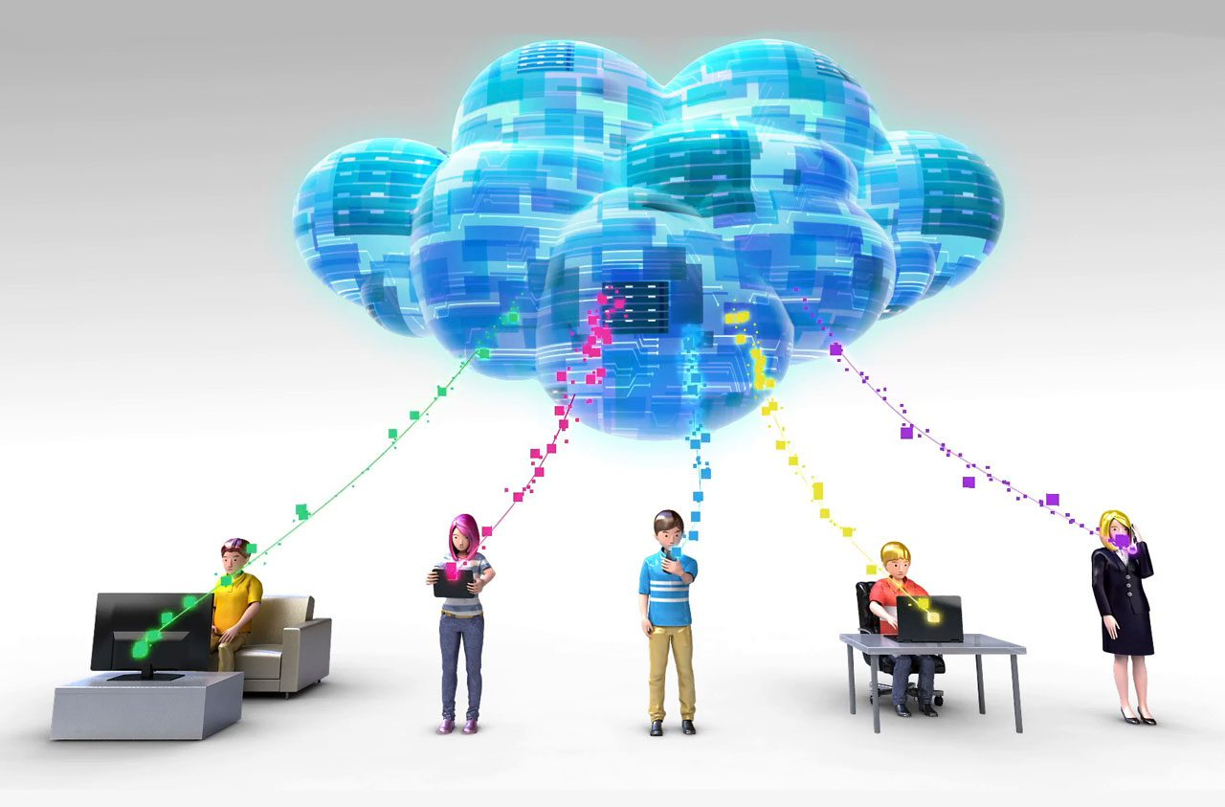
Current & Future Trends (Cloud Computing)

Slide 2
Current & Future Trends
Blockchain
AI and ML
Data Security
Multi and Hybrid Cloud Deployment
Low Code and No Code Cloud Solutions
Edge computing
IoT
Kubernetes and Docker
Serverless architecture/computing
DevSecOps
Disaster recovery and backup
Service Mesh

Slide 3
Blockchain
Blockchain is a distributed ledger technology that is being integrated with cloud computing to create new applications and services.
Cloud providers are offering blockchain-as-a-service (BaaS) solutions that enable businesses to build and deploy blockchain applications in the cloud.

Slide 4
AI and ML
Artificial Intelligence and Machine Learning are the cost-effective technologies.
AI and ML require high computational power and storage for the collection of data and training.
Major trends in this sector upcoming years are:
self-automation,
self-learning,
personalized cloud,
high data security, and
privacy.

Slide 5
Data Security
When it comes to data security, no business or organization wants to compromise.
Threats such as data leaks, data deletion, and unauthorized amendments to the data need to be minimized.
Data breaches can be minimized with the help of encryption and authentication.
Data losses can be reduced with the help of backups, reviewing privacy policies, and data recovery systems.
Security testing will be done thoroughly to detect any loopholes and patches.
High-security measures should be taken during storage and transfer of data. Cloud service providers secure the data with many security protocols and data encryption algorithms.

Slide 6
Multi and Hybrid Cloud Deployment
Many organizations like banks, insurance companies, that are using hybrid cloud service that offers a combination of both private and public clouds to store their data.
Businesses are dividing their workload among multiple cloud service providers to control their data and resources as well as utilize the strength of each cloud service provider.
The use of multi-cloud minimizes the potential risks and failure points and provides cost-effectiveness.
In multi-cloud, you can choose a particular service of a particular cloud service provider that meets your requirements instead of deploying your entire application on that cloud.

Slide 7
Low Code and No Code Cloud Solutions
when users need to write hundreds of lines of code to create applications and solve real-world problems and have deep technical knowledge.
Businesses can create applications and make use of AI and its sub-domains with low-code and no-code cloud solutions.
This helps in reducing the time and cost involved to create these solutions. These solutions increase product development speed and result in a smaller number of errors.
Tools such as Figma and Zoho enable users to design and develop websites, apps, and services without any computing infrastructure and coding knowledge involved.

Slide 8
Edge computing
Edge computing includes storage of data, data processing, and data analytics which is done geographically nearer to the source.
It means that the computation and storage of data are brought closer to the source sensors and devices.
It provides many benefits like
reduced latency,
enhanced efficiency,
increased privacy,
security, and
high rate of data transmission.
It works in real-time and processes data that is not bounded by time.

Slide 9
IoT
IoT involves the use of many sensors that generate huge amounts of data which gets storage on cloud servers.
IoT makes use of many sensors, and actuators and performs analysis on the data collected to yield results that will help in taking business decisions.
It involves connectivity among computers, networks, and servers.
It can remotely collect data and communicate with the devices.
IoT collects data from various sensors and devices and acts as an intermediator between remote systems and smart device management.
Smart connectivity plays a major role in making IoT a trend in cloud computing.

Slide 10
Kubernetes and Docker
Kubernetes is an open-source orchestration platform where scaling, management, and deployment of applications is done automatically.
Docker is a platform where developers can package applications and can deploy them anywhere in the form of containers.
They manages services and workloads from a single location while running applications from a single source.
They provide scalability and efficiency to many large-scale deployments.

Slide 11
Serverless Computing
Serverless computing is a methodology that provides backend services on a per-user basis. There is no need for developers to manage the servers while running their code.
Code execution is managed by the cloud service provider. Cloud users will pay as per the pay-as-you-go format which means that users will only pay when their code runs instead for a fixed server.
Serverless architecture offers many advantages such as:
No requirement for system administration,
Low cost and liability,
Easy management of operations, and
Enhanced user experience even in case of no internet.

Slide 12
DevSecOps
DevSecOps is an integration of security with the ongoing development process. It embeds many processes in its workflow to ensure secure task automation.
Many cloud service providers provide various tools and services to help businesses apply DevSecOps methods.
Cloud computing provides many benefits to its customers in managing their data but along with that, many security issues are sometimes faced by the users like:
Risks involving network invasion,
Denial of Service (DoS) attacks,
issues in virtualization,
unauthorized use of data

Slide 13
Disaster recovery and backup
It is becoming a vital aspect for businesses since they prefer moving their operations to the cloud.
Cloud providers are developing disaster recovery solutions that enable businesses to quickly recover from disruptions such as natural disasters, hardware failures or cyberattacks.
Many enterprises keep electronic records and files and upload those documents on an external cloud server automatically.

Slide 14
Service Mesh
Service mesh is a technology that provides a network of microservices with features like:
Load balancing,
Traffic management, and
Security.
Cloud providers are offering service mesh solutions to help organizations manage their microservices.

